Slide 1
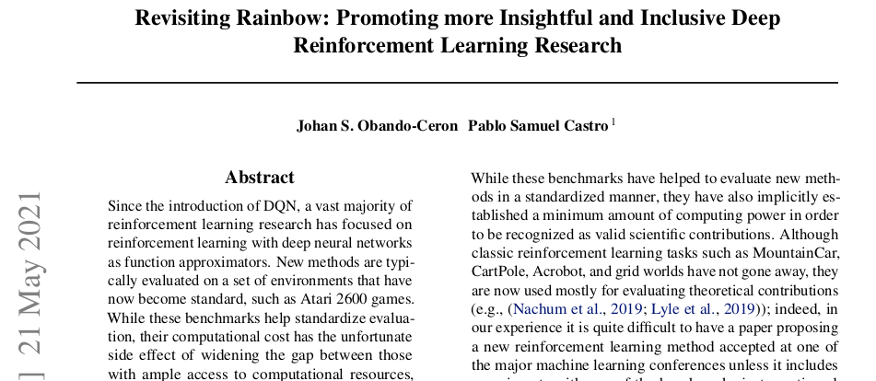

Slide 2
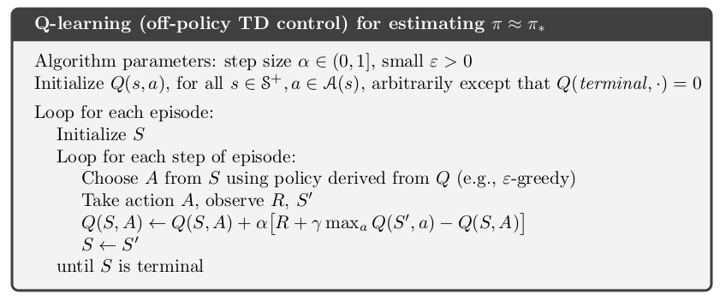
Q-learning
Sutton & Barto, 2018, p 131

Slide 3
Q-learning

Slide 4
Q-learning

Slide 5
Q-learning
1
0

Slide 6
Q-learning
0
0
0
0
1
0
0
0
0
0

Slide 7
Q-learning
Step size (α) = 0.5
Discount factor (γ) = 0.9
Policy (π): ε-greedy, except for ties
1
0

Slide 8
Q-learning
Step size (α) = 0.5
Discount factor (γ) = 0.9
Policy (π): ε-greedy, except for ties
0
0
0
0
0
0
1
0
0
0
0
0
0

Slide 9
Q-learning
Step size (α) = 0.5
Discount factor (γ) = 0.9
Policy (π): ε-greedy, except for ties
0
0
0
0
0
0
1
0
0
0
0
0
0

Slide 10
Q-learning
Step size (α) = 0.5
Discount factor (γ) = 0.9
Policy (π): ε-greedy, except for ties
0
0
0
0
0
0
1
0
0
0
0
0
0

Slide 11
Q-learning
Step size (α) = 0.5
Discount factor (γ) = 0.9
Policy (π): ε-greedy, except for ties
0
0
0
0
0
0
1
0
0
0
0
0
0

Slide 12
Q-learning
Step size (α) = 0.5
Discount factor (γ) = 0.9
Policy (π): ε-greedy, except for ties
0
0
0
0
0
0
1
0
0
0
0
0
0

Slide 13
Q-learning
Step size (α) = 0.5
Discount factor (γ) = 0.9
Policy (π): ε-greedy, except for ties
0
0
0
0
0
0
1
0
0
0
0
0
0

Slide 14
Q-learning
Step size (α) = 0.5
Discount factor (γ) = 0.9
Policy (π): ε-greedy, except for ties
0
0
0
0
0
0
1
0
0
0
0
0
0

Slide 15
Q-learning
Step size (α) = 0.5
Discount factor (γ) = 0.9
Policy (π): ε-greedy, except for ties
0
0
0
0
0
0
1
0
0
0
0
0
0

Slide 16
Q-learning
Step size (α) = 0.5
Discount factor (γ) = 0.9
Policy (π): ε-greedy, except for ties
0
0
0
0
0
0
1
0
0
0
0
0
0

Slide 17
Q-learning
Step size (α) = 0.5
Discount factor (γ) = 0.9
Policy (π): ε-greedy, except for ties
0
0
0
0
0
0
1
+0
0
0
0
0
0

Slide 18
Q-learning
Step size (α) = 0.5
Discount factor (γ) = 0.9
Policy (π): ε-greedy, except for ties
0
0
0
0
0
0
1
0
0
0
0
0
0

Slide 19
Q-learning
Step size (α) = 0.5
Discount factor (γ) = 0.9
Policy (π): ε-greedy, except for ties
0
0
0
0
0
0
1
0
0
0
0
0
0

Slide 20
Q-learning
Step size (α) = 0.5
Discount factor (γ) = 0.9
Policy (π): ε-greedy, except for ties
0
0
0
0
0
0
1
0
0
0
0
0
0

Slide 21
Q-learning
Step size (α) = 0.5
Discount factor (γ) = 0.9
Policy (π): ε-greedy, except for ties
0
0
0
0
0
0
1
0
0
0
0
0
0

Slide 22
Q-learning
Step size (α) = 0.5
Discount factor (γ) = 0.9
Policy (π): ε-greedy, except for ties
0
0
0
0
0
0
1
0
0
0
0
0
0

Slide 23
Q-learning
Step size (α) = 0.5
Discount factor (γ) = 0.9
Policy (π): ε-greedy, except for ties
0
0
0
0
0
0
1
0
0
0
0
0
0

Slide 24
Q-learning
Step size (α) = 0.5
Discount factor (γ) = 0.9
Policy (π): ε-greedy, except for ties
0
0
0
0
0
0
1
0
0
0
0
0
0

Slide 25
Q-learning
Step size (α) = 0.5
Discount factor (γ) = 0.9
Policy (π): ε-greedy, except for ties
0
0
0
0
0
0
1
0
0
0
0
0
0

Slide 26
Q-learning
Step size (α) = 0.5
Discount factor (γ) = 0.9
Policy (π): ε-greedy, except for ties
0
0
0
0
0
0
+1
0
0
0
0
0
0

Slide 27
Q-learning
Step size (α) = 0.5
Discount factor (γ) = 0.9
Policy (π): ε-greedy, except for ties
0
0
0
0
0
0
0
+1
0
0
0
0
0
0

Slide 28
Q-learning
Step size (α) = 0.5
Discount factor (γ) = 0.9
Policy (π): ε-greedy, except for ties
0
0
0
0
0
0
0
0
+1
0
0
0
0
0
0

Slide 29
Q-learning
Step size (α) = 0.5
Discount factor (γ) = 0.9
Policy (π): ε-greedy, except for ties
0.9
0
0
0
0
0
0
0
0
+1
0
0
0
0
0
0

Slide 30
Q-learning
Step size (α) = 0.5
Discount factor (γ) = 0.9
Policy (π): ε-greedy, except for ties
1
0.9
0
0
0
0
0
0
0
0
+1
0
0
0
0
0
0

Slide 31
Q-learning
Step size (α) = 0.5
Discount factor (γ) = 0.9
Policy (π): ε-greedy, except for ties
1
0
0
0
0
0
0
+1
0
0
0
0
0
0

Slide 32
Q-learning
Step size (α) = 0.5
Discount factor (γ) = 0.9
Policy (π): ε-greedy, except for ties
0.5
1
0
0
0
0
0
0
+1
0
0
0
0
0
0

Slide 33
Q-learning
Step size (α) = 0.5
Discount factor (γ) = 0.9
Policy (π): ε-greedy, except for ties
0.5
0
0
0
0
0
0
+1
0
0
0
0
0
0

Slide 34
Q-learning
Step size (α) = 0.5
Discount factor (γ) = 0.9
Policy (π): ε-greedy, except for ties
0
0.5
0
0
0
0
0
0
+1
0
0
0
0
0
0

Slide 35
Q-learning
Step size (α) = 0.5
Discount factor (γ) = 0.9
Policy (π): ε-greedy, except for ties
0.5
0
0
0
0
0
0
+1
0
0
0
0
0
0

Slide 36
Q-learning
Step size (α) = 0.5
Discount factor (γ) = 0.9
Policy (π): ε-greedy, except for ties
0.5
0
0
0
0
0.5
+1
0
0
0
0
0
0

Slide 37
Q-learning
Step size (α) = 0.5
Discount factor (γ) = 0.9
Policy (π): ε-greedy, except for ties
0
0
0
0
0.5
1
0
0
0
0
0
0

Slide 38
Q-learning
Step size (α) = 0.5
Discount factor (γ) = 0.9
Policy (π): ε-greedy, except for ties
0
0
0
0
0.5
1
0
0
0
0
0
0

Slide 39
Q-learning
Step size (α) = 0.5
Discount factor (γ) = 0.9
Policy (π): ε-greedy, except for ties
0
0
0
0
0.5
1
0
0
0
0
0
0

Slide 40
Q-learning
Step size (α) = 0.5
Discount factor (γ) = 0.9
Policy (π): ε-greedy, except for ties
0
0
0
0
0.5
1
0
0
0
0
0
0

Slide 41
Q-learning
Step size (α) = 0.5
Discount factor (γ) = 0.9
Policy (π): ε-greedy, except for ties
0
0
0
0
0
0.5
1
0
0
0
0
0
0

Slide 42
Q-learning
Step size (α) = 0.5
Discount factor (γ) = 0.9
Policy (π): ε-greedy, except for ties
0.5
0
0
0
0
0
0.5
1
0
0
0
0
0
0

Slide 43
Q-learning
Step size (α) = 0.5
Discount factor (γ) = 0.9
Policy (π): ε-greedy, except for ties
0.9
0.5
0
0
0
0
0
0.5
1
0
0
0
0
0
0

Slide 44
Q-learning
Step size (α) = 0.5
Discount factor (γ) = 0.9
Policy (π): ε-greedy, except for ties
0
0.9
0.5
0
0
0
0
0
0.5
+0
1
0
0
0
0
0
0

Slide 45
Q-learning
Step size (α) = 0.5
Discount factor (γ) = 0.9
Policy (π): ε-greedy, except for ties
0
0.45
0
0
0
0
0
0.5
+0
1
0
0
0
0
0
0

Slide 46
Q-learning
Step size (α) = 0.5
Discount factor (γ) = 0.9
Policy (π): ε-greedy, except for ties
0.45
0
0
0
0
0.5
1
0
0
0
0
0
0

Slide 47
Q-learning
Step size (α) = 0.5
Discount factor (γ) = 0.9
Policy (π): ε-greedy, except for ties
0.5
0.45
0
0
0
0
0.5
1
0
0
0
0
0
0

Slide 48
Q-learning
Step size (α) = 0.5
Discount factor (γ) = 0.9
Policy (π): ε-greedy, except for ties
0.23
0
0
0
0
0.5
1
0
0
0
0
0
0

Slide 49
Q-learning
Step size (α) = 0.5
Discount factor (γ) = 0.9
Policy (π): ε-greedy, except for ties
0
0.23
0
0
0
0
0.5
1
0
0
0
0
0
0

Slide 50
Q-learning
Step size (α) = 0.5
Discount factor (γ) = 0.9
Policy (π): ε-greedy, except for ties
0.23
0
0
0
0
0.5
1
0
0
0
0
0
0

Slide 51
Q-learning
Step size (α) = 0.5
Discount factor (γ) = 0.9
Policy (π): ε-greedy, except for ties
0.23
0
0
0
0.23
0.5
1
0
0
0
0
0
0

Slide 52
Q-learning
Step size (α) = 0.5
Discount factor (γ) = 0.9
Policy (π): ε-greedy, except for ties
0
0
0
0.23
0.5
1
0
0
0
0
0
0

Slide 53
Q-learning
Step size (α) = 0.5
Discount factor (γ) = 0.9
Policy (π): ε-greedy, except for ties
0
0
0
0.23
0.5
1
0
0
0
0
0
0

Slide 54
Q-learning
Step size (α) = 0.5
Discount factor (γ) = 0.9
Policy (π): ε-greedy, except for ties
0
0
0
0.23
0.5
+1
0
0
0
0
0
0

Slide 55
Q-learning
Step size (α) = 0.5
Discount factor (γ) = 0.9
Policy (π): ε-greedy, except for ties
0
0
0
0.23
0.75
+1
0
0
0
0
0
0

Slide 56
Q-learning
Step size (α) = 0.5
Discount factor (γ) = 0.9
Policy (π): ε-greedy, except for ties
0
0
0.10
0.45
0.88
+1
0
0
0
0
0
0

Slide 57
Q-learning
Step size (α) = 0.5
Discount factor (γ) = 0.9
Policy (π): ε-greedy, except for ties
0
0
0.25
0.62
0.94
+1
0
0
0
0
0
0

Slide 58
Q-learning
Step size (α) = 0.5
Discount factor (γ) = 0.9
Policy (π): ε-greedy, except for ties
0
0
0.41
0.73
0.97
+1
0
0
0
0
0
0

Slide 59
Q-learning
Step size (α) = 0.5
Discount factor (γ) = 0.9
Policy (π): ε-greedy, except for ties
...after enough episodes
0.66
0.73
0.81
0.9
1
+1
0
0
0
0
0
0

Slide 60
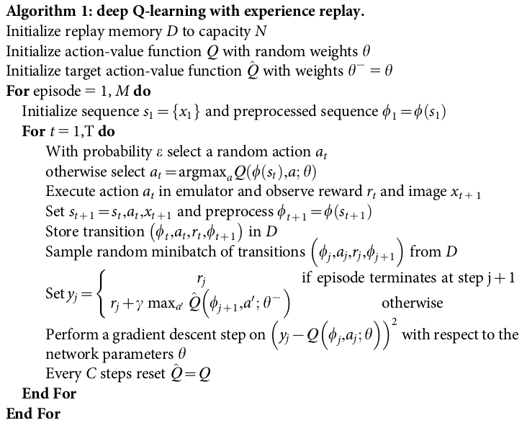
Deep Q-Network
Q-learning
Major DQN innovations, Mnih et al. (2013, 2015):
1) replay buffer a) re-use of samples → more data-efficient b) de-correlate samples → more efficient, reduce training variance c) make successive experiences independent of current weights → increase training stability
2) copy weights to target network only intermittently
3) clip update error term to [-1, 1]
Sutton & Barto, 2018, p 131
Mnih et al., 2013, 2015

Slide 61
DQN Rainbow improvements
1) Prioritized experience replay
2) Multi-step learning
3) Double Q-learning
4) Dueling networks
5) Noisy Nets
6) Distributional RL

Slide 62
Prioritized Experience Replay

Slide 63
1) Prioritized experience replay
2) Multi-step learning
3) Double Q-learning
4) Dueling networks
5) Noisy Nets
6) Distributional RL

Slide 64
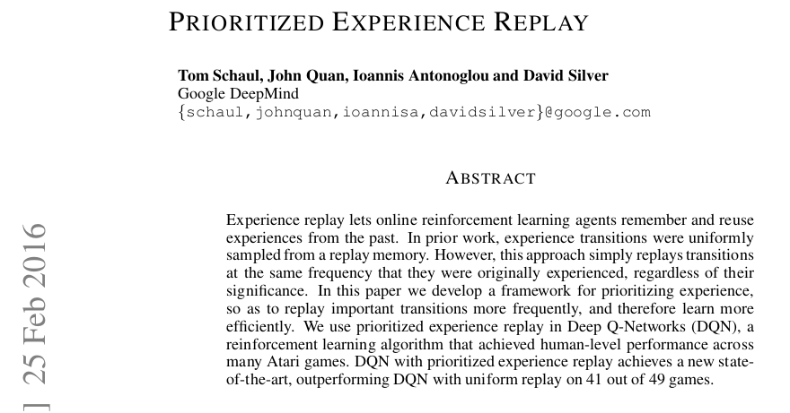
Prioritized Experience Replay

Slide 65
Prioritized Experience Replay
Schaul et al., 2016
Right 0
Right 0
Right 1
Left 0
Left 0
Right 0
Sampling from replay buffer:
  Removes correlation of consecutive events → i.i.d.
  Remembers (rare) events that might later be useful
Reduces amount of experience needed to learn well
But can we do better than uniform sampling?

Slide 66
Prioritized Experience Replay
Schaul et al., 2016
0.01
Right 0
0.45
Ideally prioritize based on how much agent can learn (“expected learning progress”)
But that’s not directly measurable
So, use temporal difference (TD) error magnitude as proxy
Right 0
0
Right 1
0.03
Left 0
0
Left 0
0
Right 0
0.02
TD error (δ)
New estimate of Q value
Current estimate of Q value

Slide 67
Prioritized Experience Replay
Schaul et al., 2016
0.01
Right 0
0.46
Ideally prioritize based on how much agent can learn (“expected learning progress”)
But that’s not directly measurable
So, use temporal difference (TD) error magnitude as proxy
Right 0
0.01
Right 1
0.04
Left 0
0.01
Left 0
0.01
Right 0
0.03
Con: TD error bad when rewards are noisy
New transitions don’t have a known TD error yet, so they receive maximum priority to encourage at least one replay
TD error (δ)
New estimate of Q value
Current estimate of Q value

Slide 68
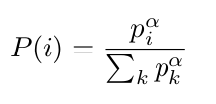
Prioritized Experience Replay
Schaul et al., 2016
0.01
Stochastic sampling:
  “interpolates between pure greedy prioritization and uniform random sampling”
  provides >0 sampling probability for all transitions
  avoids overfitting by greedy method
Right 0
0.46
Right 0
0.01
Right 1
0.04
Left 0
0.01
Left 0
0.01
Right 0
0.03
Tunable hyperparameter
Probability of selecting transition i
Priority score of transition i

Slide 69
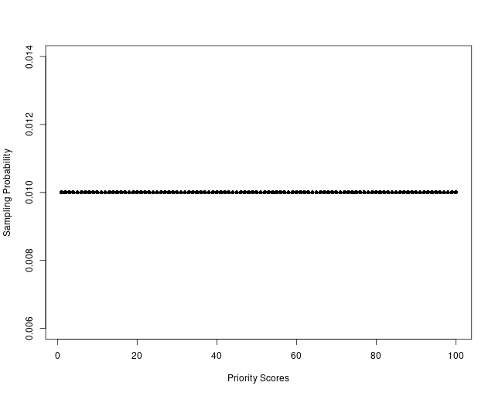
Prioritized Experience Replay
Schaul et al., 2016
α = 0
Stochastic sampling:
  “interpolates between pure greedy prioritization and uniform random sampling”
  provides >0 sampling probability for all transitions
  avoids overfitting by greedy method
Tunable hyperparameter
Probability of selecting transition i
Priority score of transition i

Slide 70
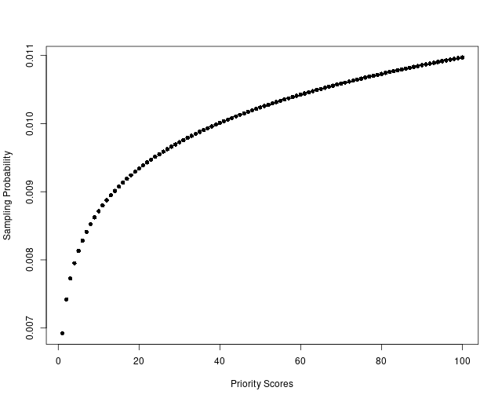
Prioritized Experience Replay
Schaul et al., 2016
α = 0.01
Stochastic sampling:
  “interpolates between pure greedy prioritization and uniform random sampling”
  provides >0 sampling probability for all transitions
  avoids overfitting by greedy method
Tunable hyperparameter
Probability of selecting transition i
Priority score of transition i

Slide 71
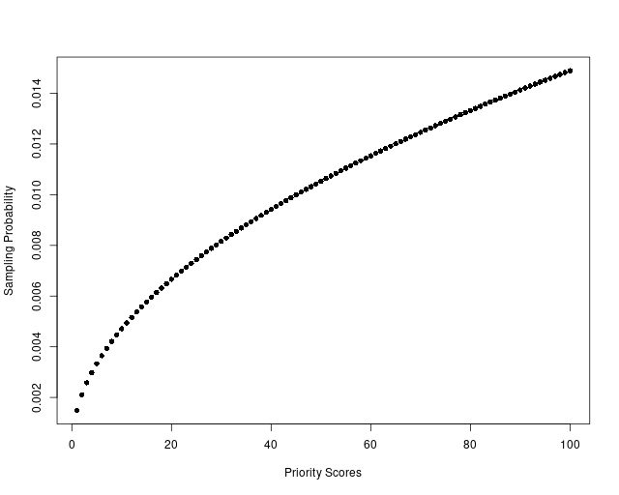
Prioritized Experience Replay
Schaul et al., 2016
α = 0.05
Stochastic sampling:
  “interpolates between pure greedy prioritization and uniform random sampling”
  provides >0 sampling probability for all transitions
  avoids overfitting by greedy method
Tunable hyperparameter
Probability of selecting transition i
Priority score of transition i

Slide 72
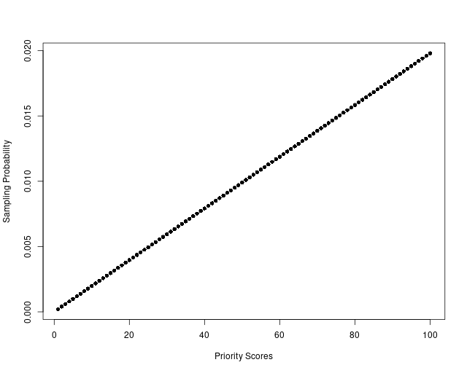
Prioritized Experience Replay
Schaul et al., 2016
α = 1
Stochastic sampling:
  “interpolates between pure greedy prioritization and uniform random sampling”
  provides >0 sampling probability for all transitions
  avoids overfitting by greedy method
Tunable hyperparameter
Probability of selecting transition i
Priority score of transition i

Slide 73
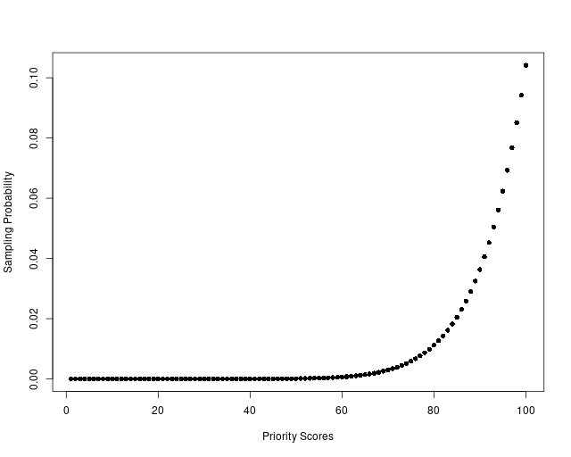
Prioritized Experience Replay
Schaul et al., 2016
α = 10
Stochastic sampling:
  “interpolates between pure greedy prioritization and uniform random sampling”
  provides >0 sampling probability for all transitions
  avoids overfitting by greedy method
Tunable hyperparameter
Probability of selecting transition i
Priority score of transition i

Slide 74
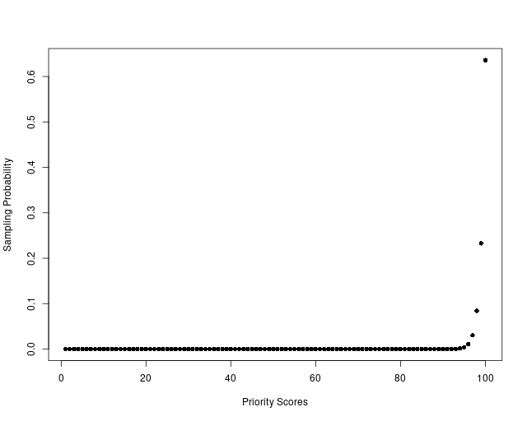
Prioritized Experience Replay
Schaul et al., 2016
α = 100
Stochastic sampling:
  “interpolates between pure greedy prioritization and uniform random sampling”
  provides >0 sampling probability for all transitions
  avoids overfitting by greedy method
Tunable hyperparameter
Probability of selecting transition i
Priority score of transition i

Slide 75
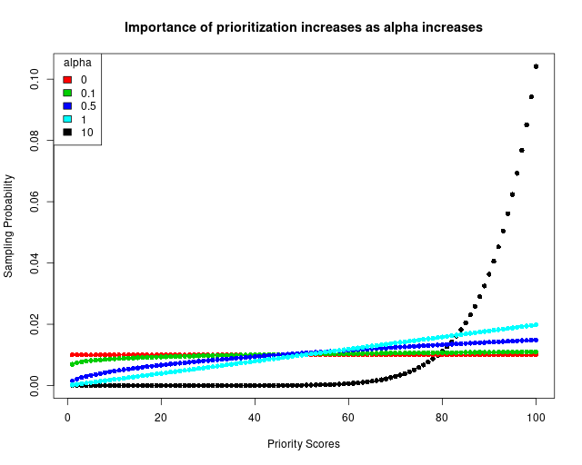
Prioritized Experience Replay
Schaul et al., 2016
Stochastic sampling:
  “interpolates between pure greedy prioritization and uniform random sampling”
  provides >0 sampling probability for all transitions
  avoids overfitting by greedy method
Tunable hyperparameter
Probability of selecting transition i
Priority score of transition i

Slide 76
Prioritized Experience Replay
Schaul et al., 2016
Stochastic sampling:
  “interpolates between pure greedy prioritization and uniform random sampling”
  provides >0 sampling probability for all transitions
  avoids overfitting by greedy method
  introduces bias in update estimates – corrected by importance sampling

Slide 77
Multi-Step Learning

Slide 78
1) Prioritized experience replay
2) Multi-step learning
3) Double Q-learning
4) Dueling networks
5) Noisy Nets
6) Distributional RL

Slide 79
Multi-Step Learning
1-step learning at end of 1st episode with termination on the right
0
0
0
0
0.5
+1
0
0
0
0
0
0

Slide 80
Multi-Step Learning
1-step learning at end of 1st episode with termination on the right
0
0
0
0
0.5
0
0
0
0
0
2-step learning at end of 1st episode with termination on the right
0.45
0
0
0
0.5
0
0
0
0
0

Slide 81
Multi-Step Learning
1-step learning at end of 2nd episode with termination on the right
0.23
0.75
0
0
0
0
0
0
0
0
2-step learning at end of 2nd episode with termination on the right
0.20
0.68
0.75
0
0
0
0
0
0
0

Slide 82
Multi-Step Learning
1-step learning at end of 3rd episode with termination on the right
0.10
0.45
0.88
0
0
0
0
0
0
0
2-step learning at end of 3rd episode with termination on the right
0.41
0.79
0.88
0
0
0
0
0
0
0

Slide 83
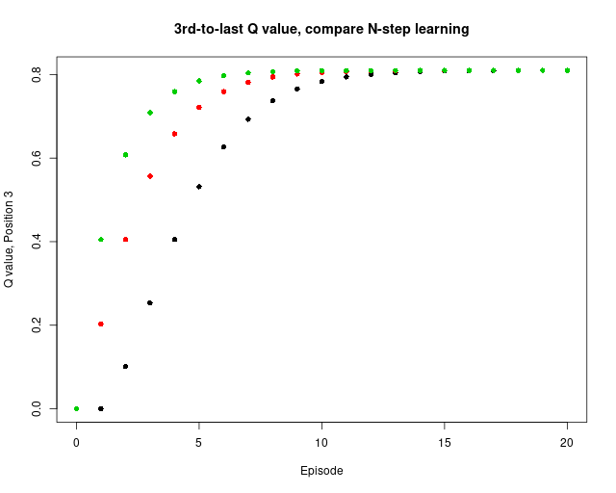
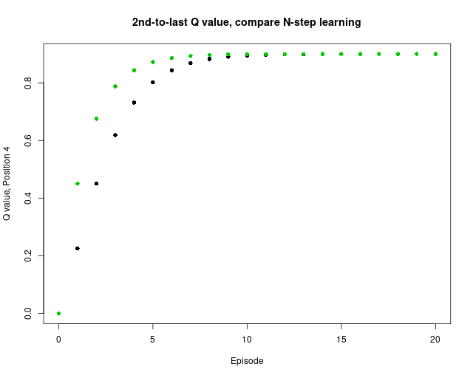
Multi-Step Learning
0.81
0.90
1
0
0
0
0
0
0
0

Slide 84
Double-Q Learning

Slide 85
Double Q-Learning
1) Prioritized experience replay
2) Multi-step learning
3) Double Q-learning
4) Dueling networks
5) Noisy Nets
6) Distributional RL

Slide 86
Double Q-Learning

Slide 87
Double Q-Learning
Evaluation
Policy π
Q values
Improvement

Slide 88
Double Q-Learning
Evaluation
Policy π
Q values
Improvement
Sutton & Barto, 2018, p 131

Slide 89
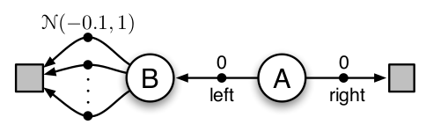
Double Q-Learning
Reward
Reward
Reward
Sutton & Barto, 2018, p 135

Slide 90
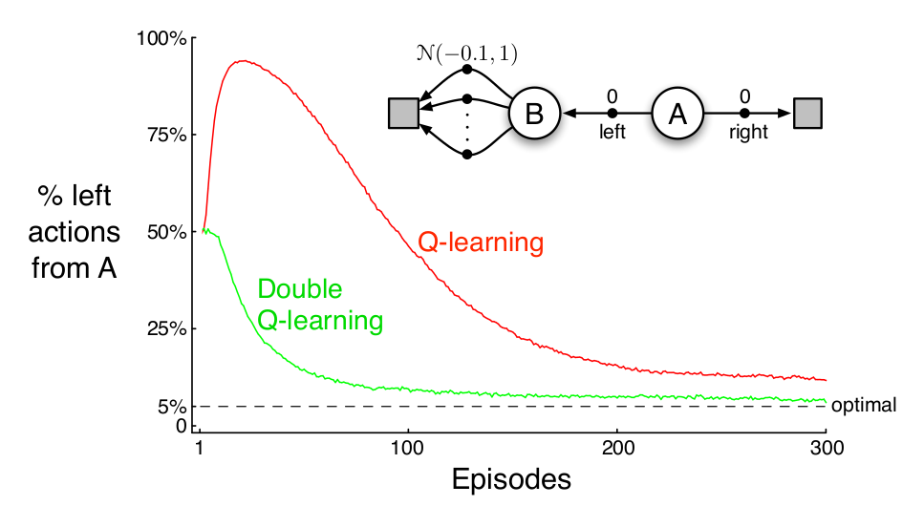
Double Q-Learning
Sutton & Barto, 2018, p 135

Slide 91
Double Q-Learning
Evaluation
Policy π
Q values
Improvement
Sutton & Barto, 2018, p 131

Slide 92
Double Q-Learning
Evaluation
Policy π
Q₂ values
Q₁ values
Improvement
Sutton & Barto, 2018, p 131

Slide 93
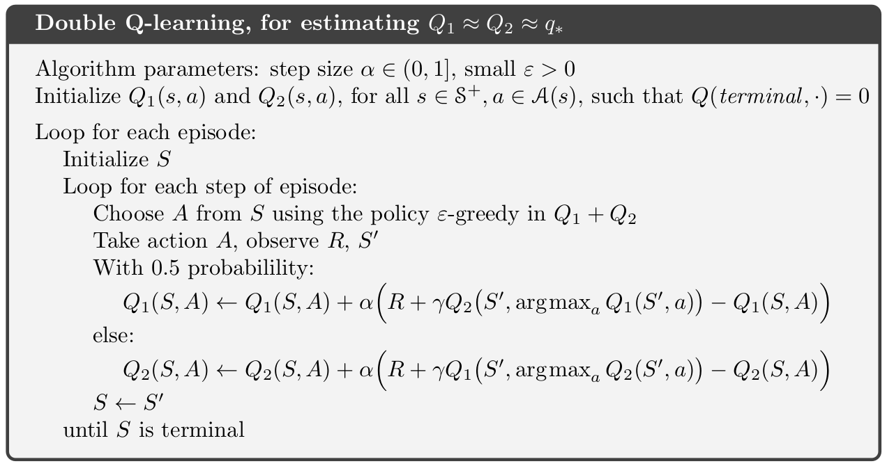
Double Q-Learning
Evaluation
Policy π
Q₂ values
Q₁ values
Improvement
Sutton & Barto, 2018, p 131

Slide 94
Double Q-Learning
Evaluation
Policy π
Q₁ values
Q₂ values
Improvement
Sutton & Barto, 2018, p 131

Slide 95
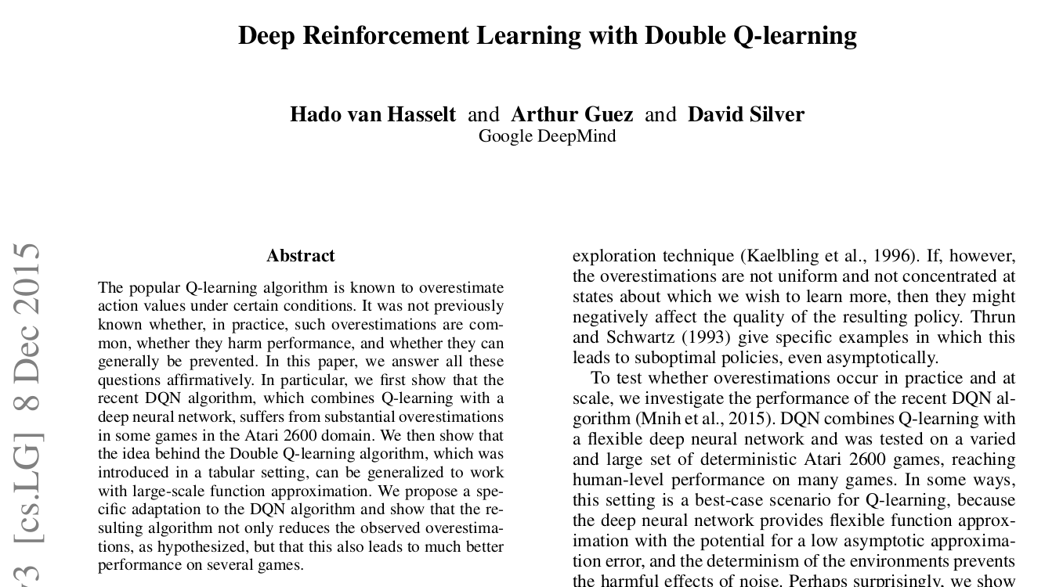
Double Q-Learning
Maximization bias occurs due to any estimation errors, regardless of source, e.g.:
  noise
  function approximation
  non-stationarity
Derive lower bound for maximization bias
  Q-learning: >0
  Double Q-learning: 0
Maximization bias produces suboptimal policies in realistic problems (Atari games)
Extend Double Q-Learning to DQN

Slide 96
Double Q-Learning
Evaluation
Policy π
Q₁ values
Q₂ values
Improvement
Copy from Q_{online} to Q_{target}
Mnih et al., 2013, 2015 van Hasselt et al., 2015

Slide 97
Double Q-Learning
Evaluation
Policy π
Q_{target}
Q_{online}
Improvement
Copy from Q_{online} to Q_{target}
Mnih et al., 2013, 2015 van Hasselt et al., 2015

Slide 98
Dueling Networks

Slide 99
1) Prioritized experience replay
2) Multi-step learning
3) Double Q-learning
4) Dueling networks
5) Noisy Nets
6) Distributional RL

Slide 100
Dueling Networks
0.66
0.73
0.81
0.9
1
Q(S, A) action values
0
0
0
0
0
V(S) state values
0
0.59
0.66
0.73
0.81
0.9
1

Slide 101
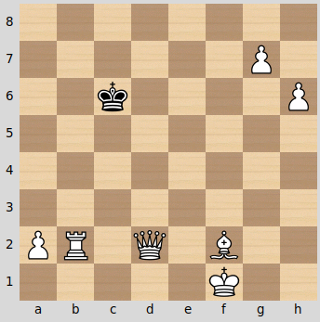
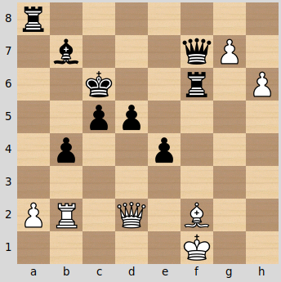
Dueling Networks
White: V(S₁) > V(S₂)
Black: V(S₁) < V(S₂)

Slide 102
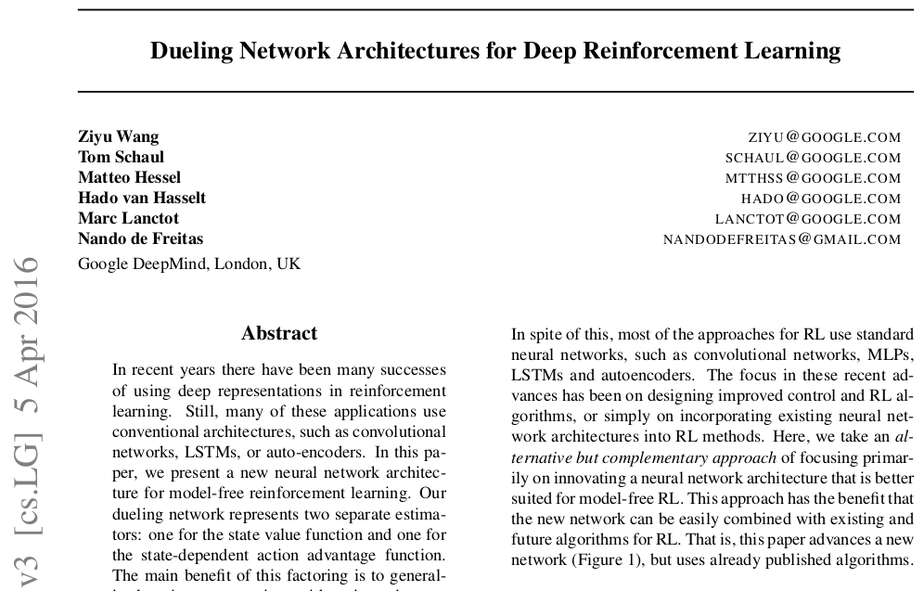
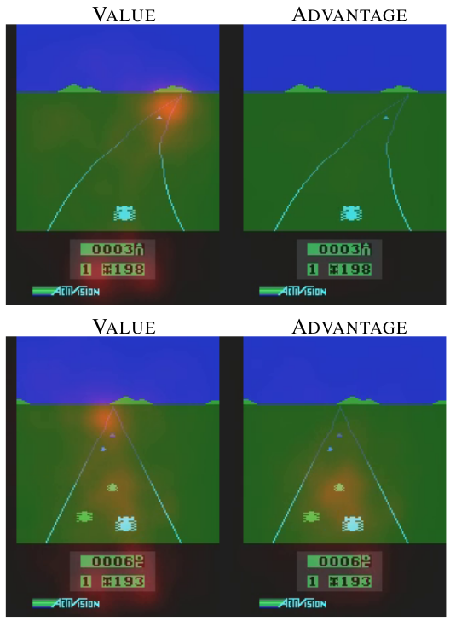
Dueling Networks
“… for many states it is unnecessary to estimate the value of each action choice.”

Slide 103

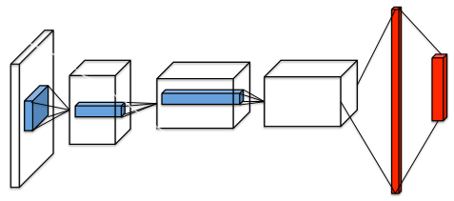
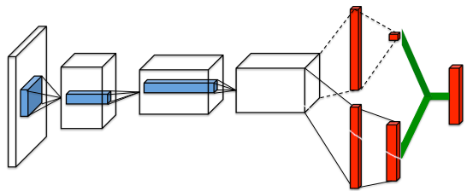
Dueling Networks
How good to choose action a compared to other available actions while in state s?
How good to be in state s?
How good to choose action a while in state s?
Wang et al., 2015

Slide 104
Noisy Nets

Slide 105
1) Prioritized experience replay
2) Multi-step learning
3) Double Q-learning
4) Dueling networks
5) Noisy Nets
6) Distributional RL

Slide 106
Noisy Nets
Training Policy (π): ε-greedy
Encourage exploration
(Post-Training: optimal policy is always greedy)
If ε = 20%,
Right: 90%
Left: 10%
0.66
0.73
0.81
0.9
1
1
0
0
0
0
0
0

Slide 107
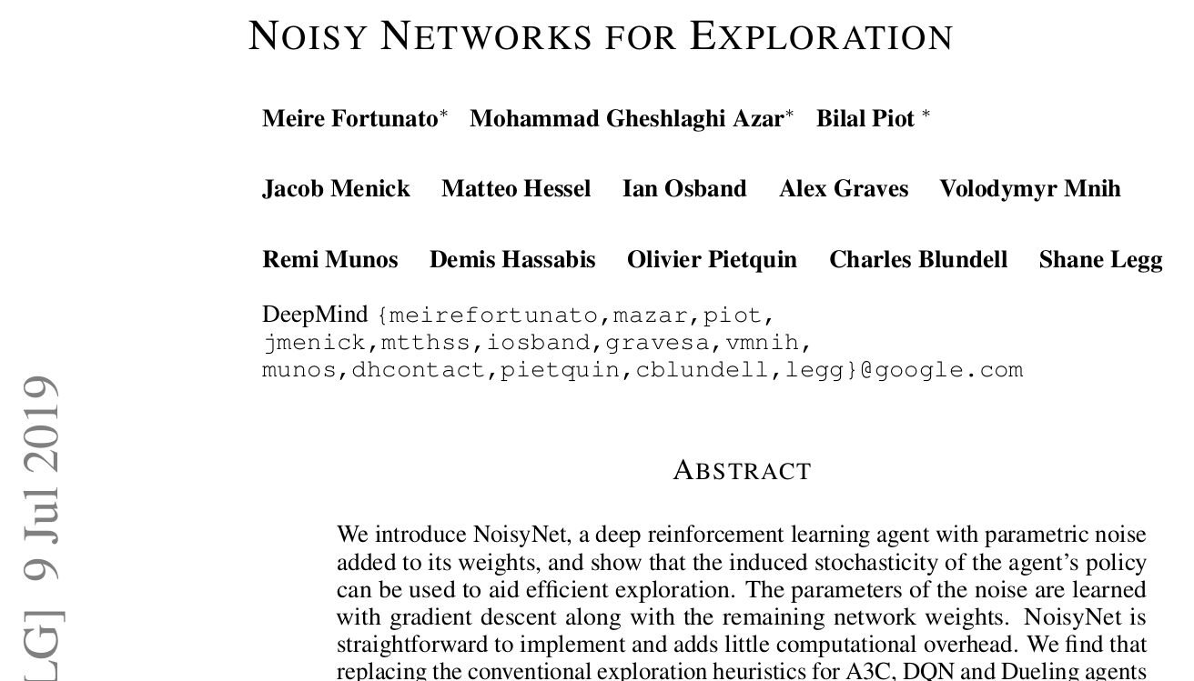
Noisy Nets
“… a single change to the weight vector can induce a consistent, and potentially very complex, state-dependent change in policy over multiple time steps...”

Slide 108

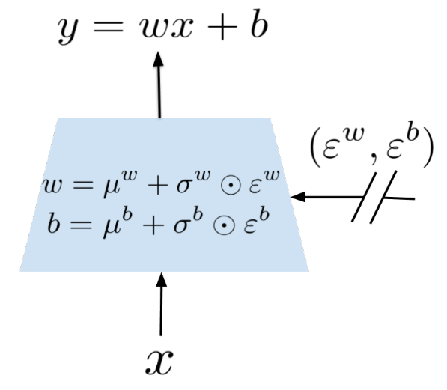

Noisy Nets
p inputs q outputs
q
q
p
p
Learnable parameters
Unit Gaussian noise
q
q
q
p
q
q
q
p
p
p
Fortunato et al., 2019

Slide 109


Independent Gaussian
Factorized Gaussian
Noisy Nets
q
q
q
q
p
p
pq + q noise variables
p + q noise variables
Learnable parameters
Unit Gaussian noise
q
q
q
p
q
q
q
p
p
p
Fortunato et al., 2019
Sample noisy parameters after each optimization step
Noisy network parameter sample is constant across mini-batch
Policy is greedy for randomized action values
Separate noisy sample generated to choose action

Slide 110
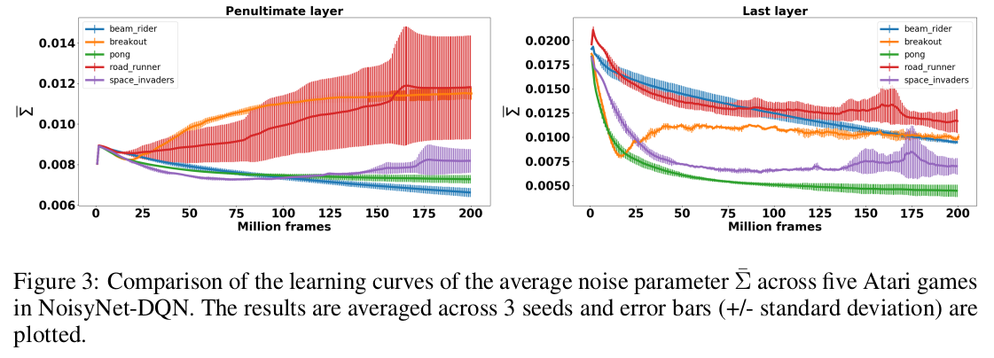
Noisy Nets
Fortunato et al., 2019
Σ measures stochasticity of noisy layers
Σ decreases during training for last layer, but sometimes rises for penultimate layer
  Authors argue that agent does not necessarily learn a deterministic solution (is that a sound conclusion based only on penultimate layer?)
Authors argue that agent pursues “problem-specific exploration strategy”, unlike “fixed exploration strategy” of regular DQN

Slide 111
Distributional RL

Slide 112
1) Prioritized experience replay
2) Multi-step learning
3) Double Q-learning
4) Dueling networks
5) Noisy Nets
6) Distributional RL

Slide 113
Distributional RL

Slide 114
Rainbow

Slide 115
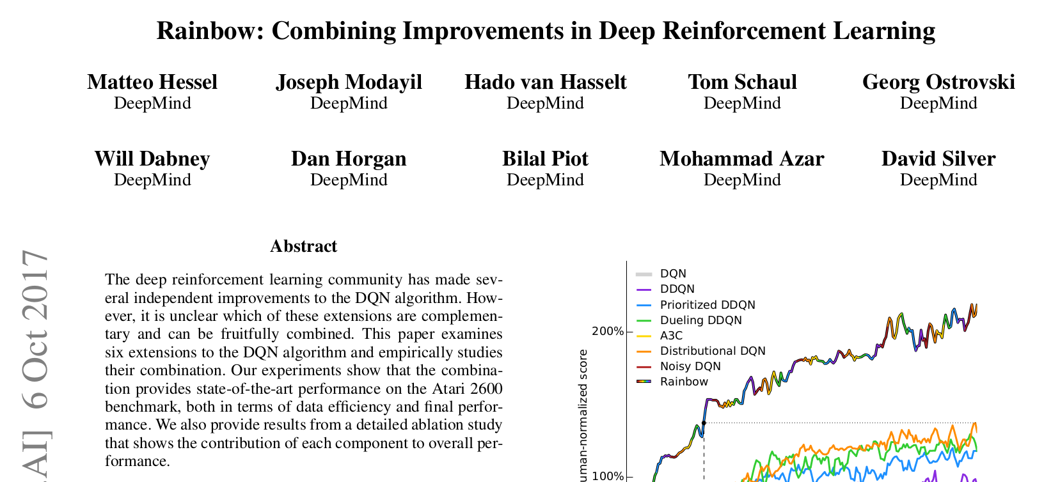
Rainbow

Slide 116
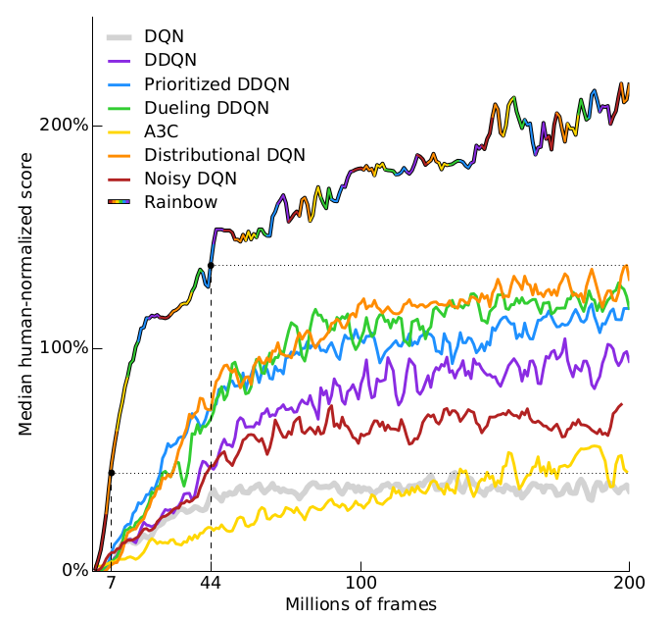
Rainbow
Addition
Hessel et al., 2017

Slide 117
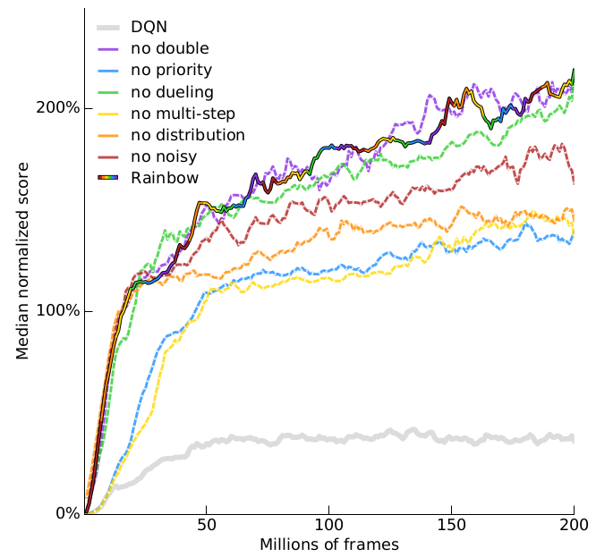
Rainbow
Addition
Ablation
Hessel et al., 2017
Prioritized replay and multi-step learning (ablation only) consistently important across games
Distributional next most-important
Noisy, Double, and Duel have variable effects, depending on measurement and game

Slide 118
Revisiting Rainbow

Slide 119
Revisiting Rainbow
Addition
Obando-Ceron et al., 2021
Prioritized replay and multi-

Slide 120
Revisiting Rainbow
Ablation
Obando-Ceron et al., 2021
Like Rainbow, concluded that components contribute to performance inconsistently across different Atari/control games
Like Rainbow, combining all components is best
Distributional RL hurts performance on some Atari/control games
Most games (except Cartpole) are robust to varying NN architecture, but 2-3 layers w/>=256 nodes each generally performed best
Rainbow is robust to varying batch sizes, but DQN does worse at batch sizes <64
Rainbow-C51 better at control, but quantile regression DQN better at mini-Atari
Results for IQN and Munchausen
Adam+MSE performed best; Adam works better with MSE than Huber; RMSprop works better with Huber than Adam
Cartpole sensitive to learning rates; might be good for testing optimizer stability
Distributional RL helpful for LunarLander
Acrobot & MountainCar have sparse rewards, so good for testing exploration (Noisy Nets helps for both)

